Slide 1
Design Project 2
16GHz Patch Antenna

Slide 2
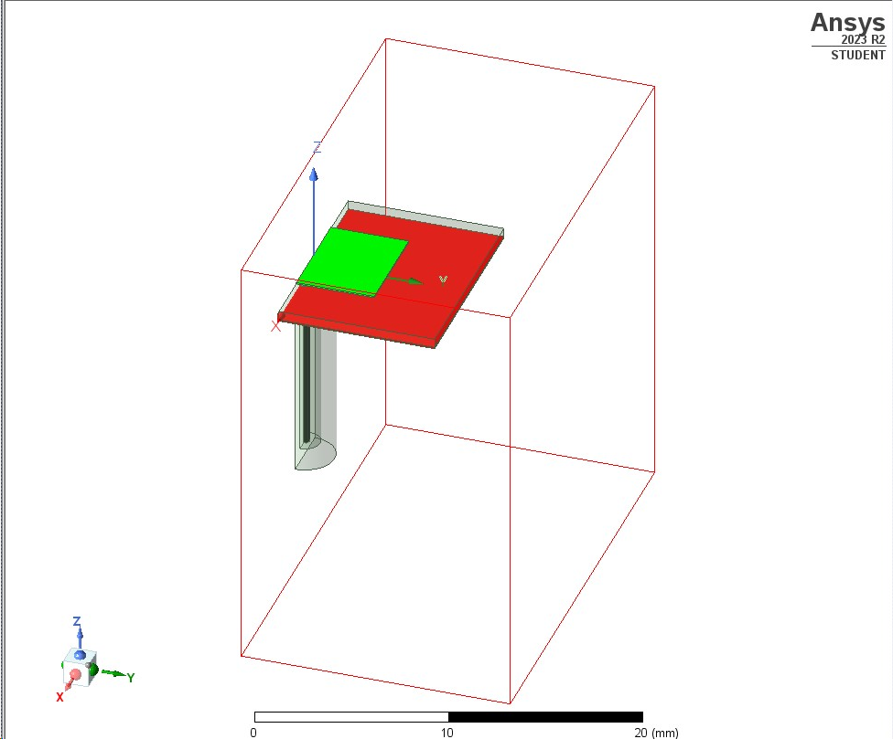
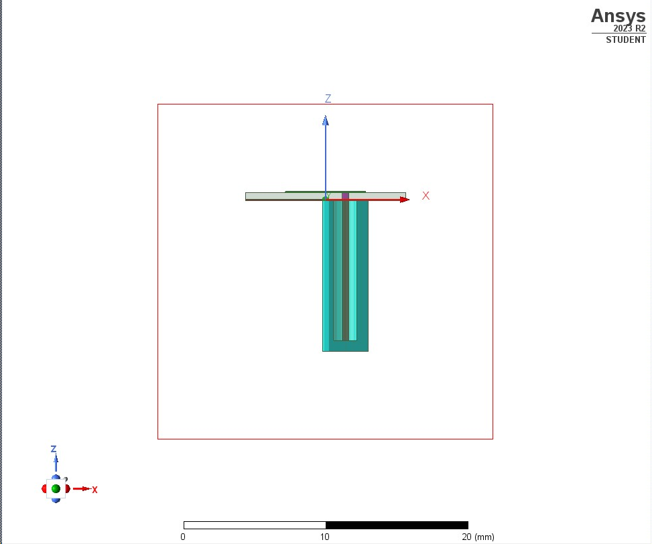

Slide 3
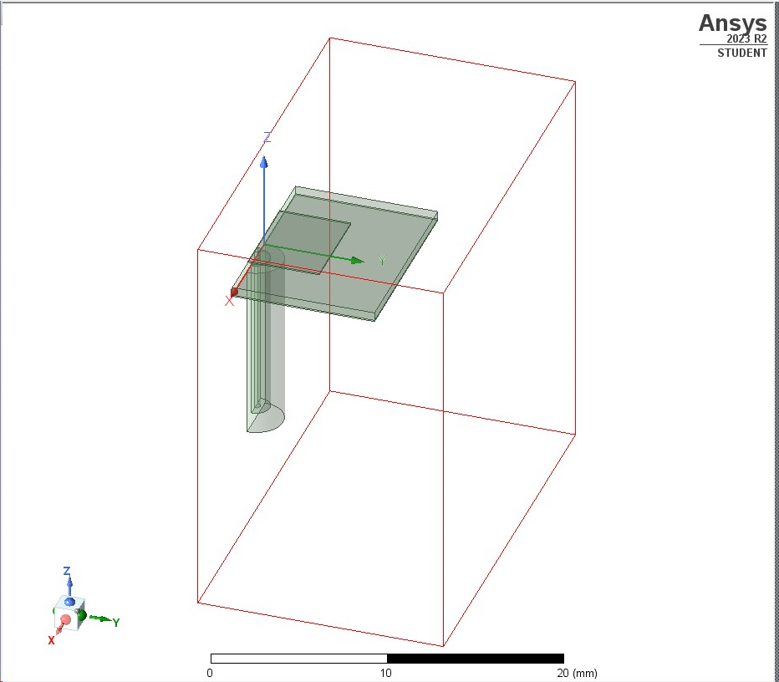
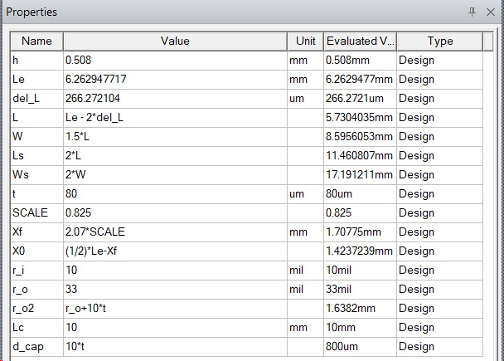

Slide 4
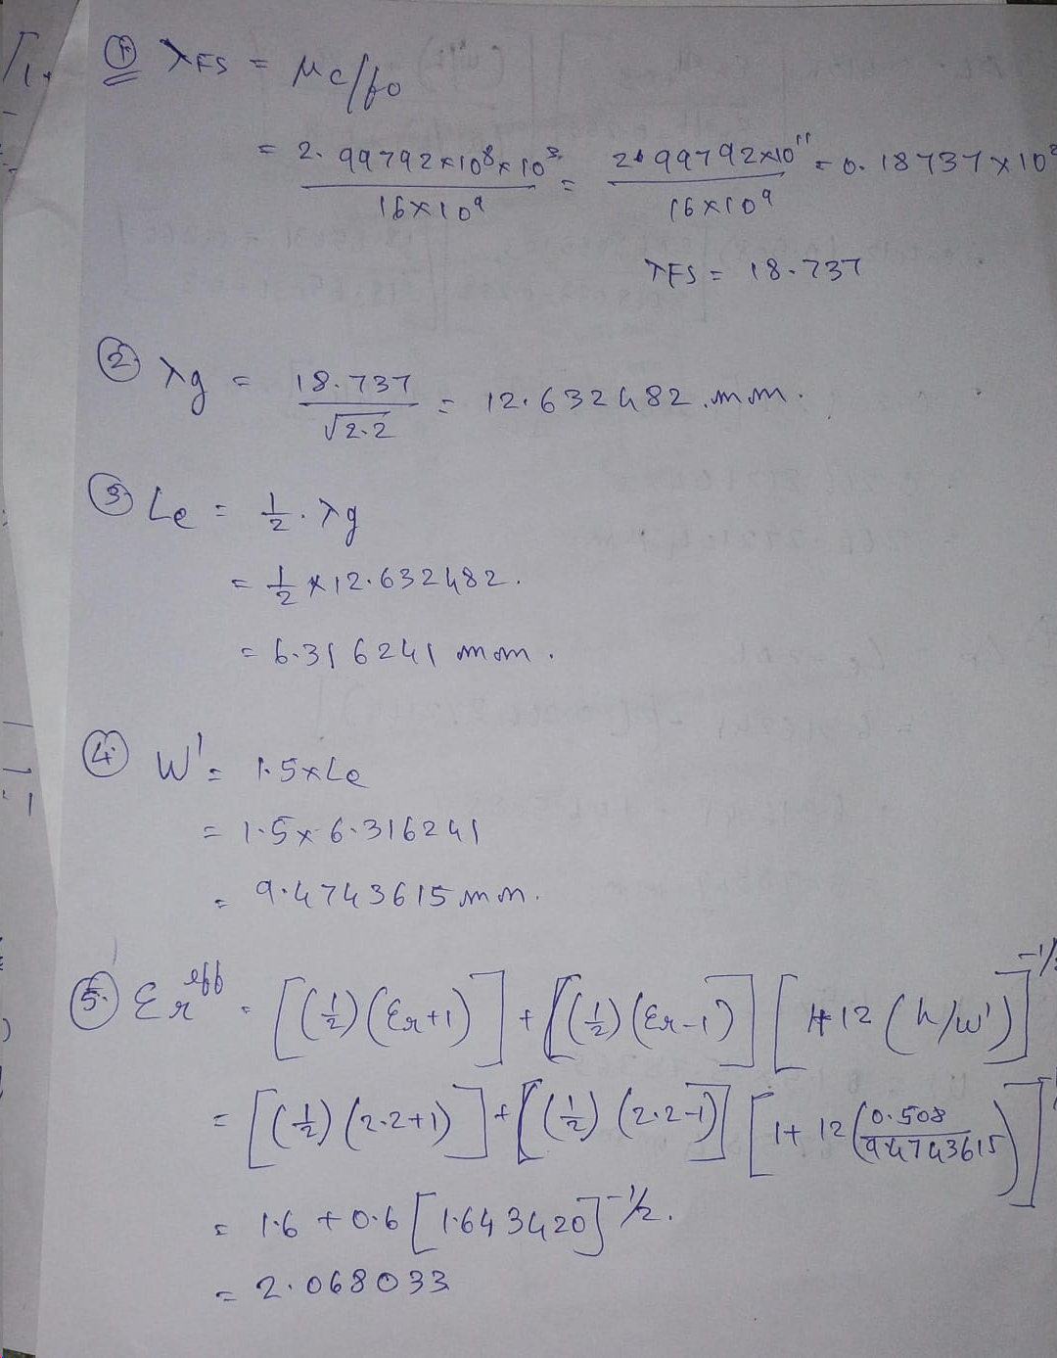
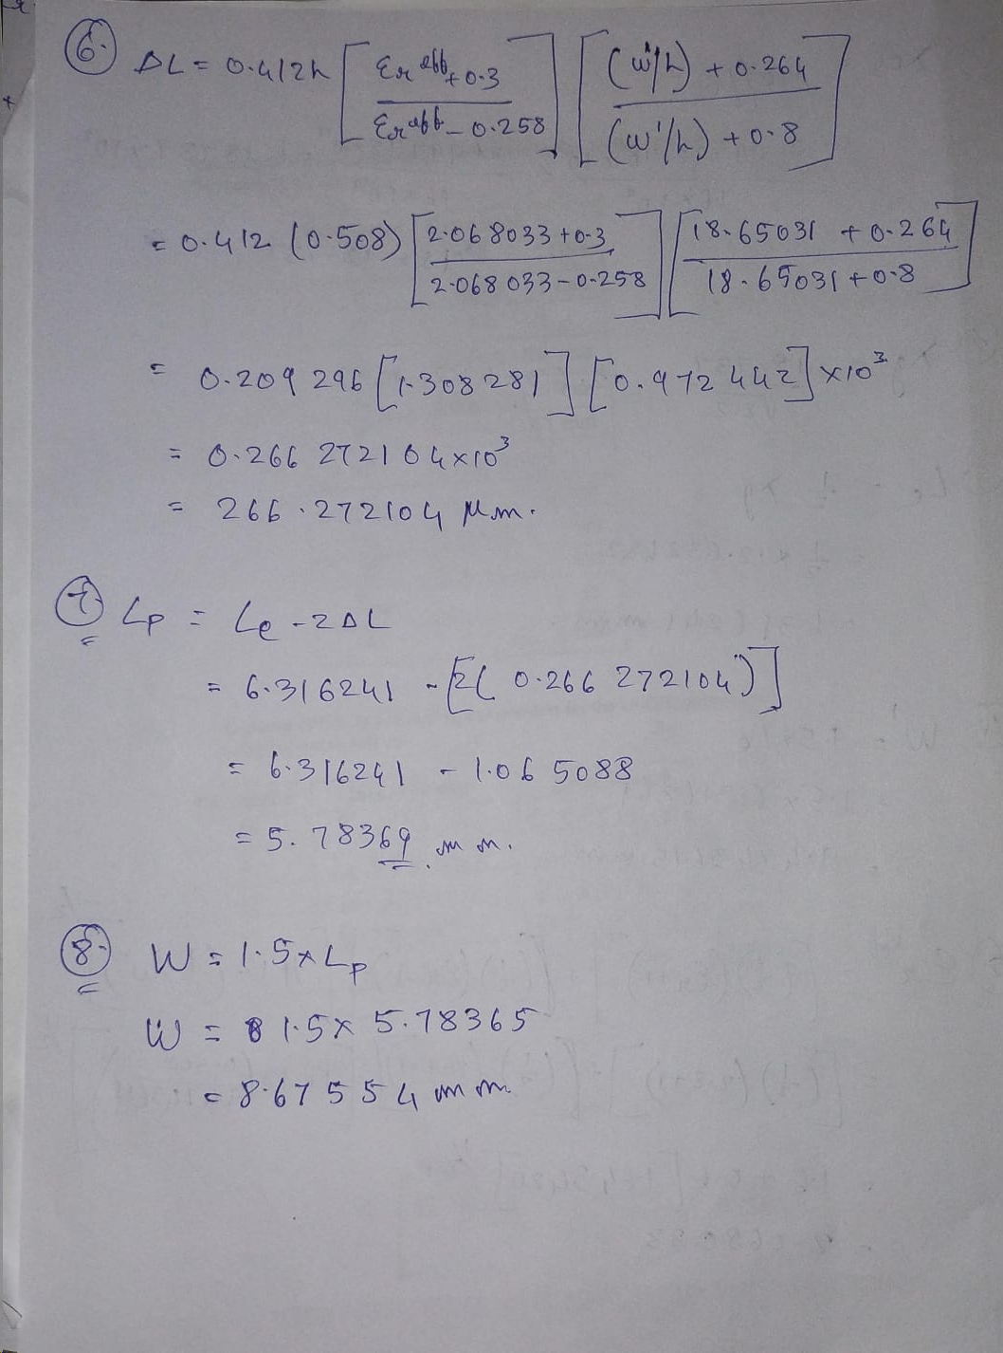
Calculations

Slide 5
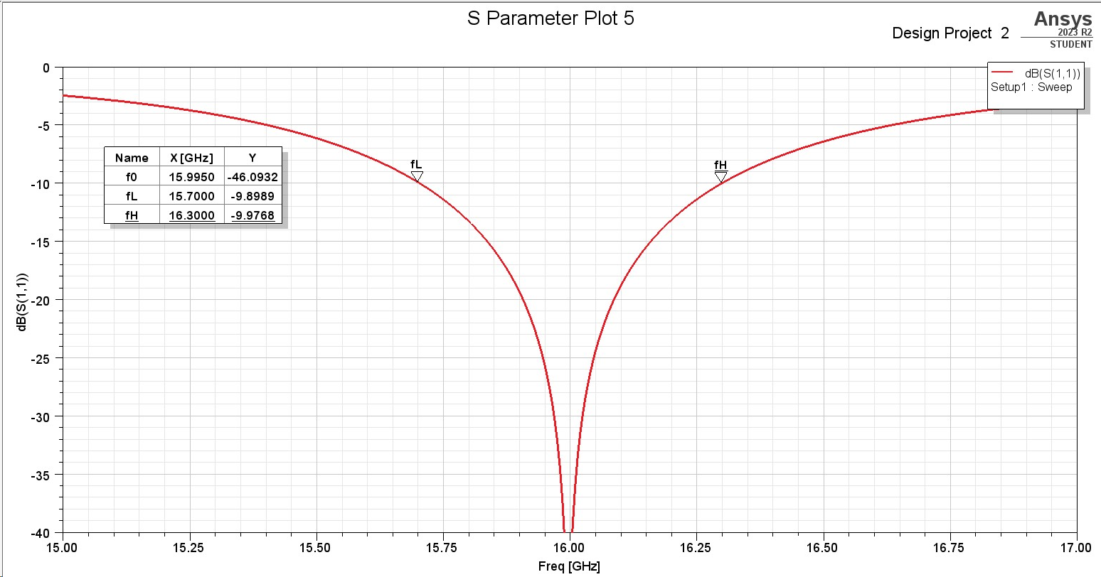

Slide 6
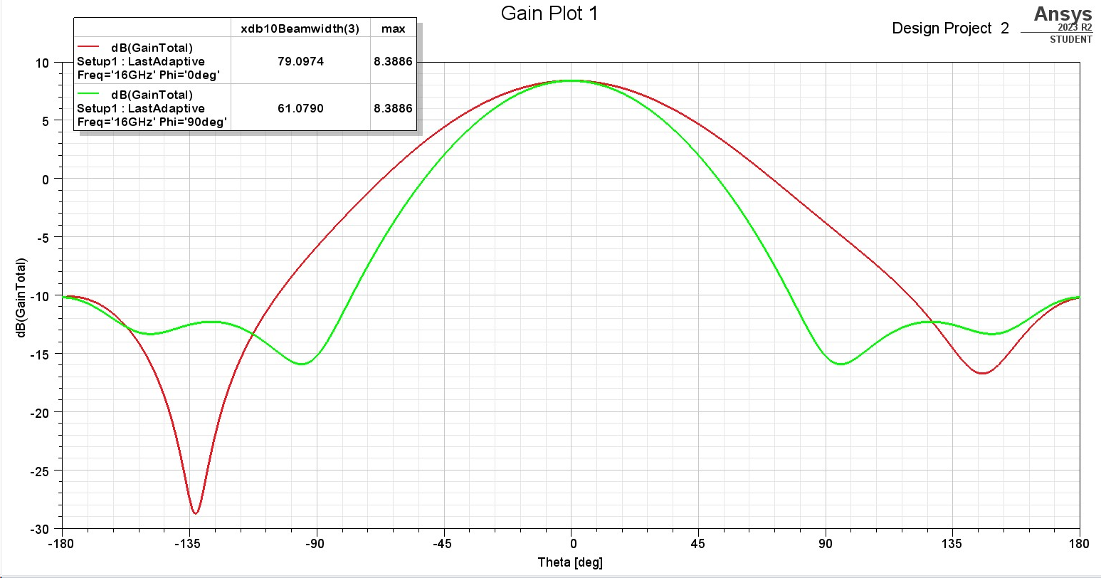

Slide 7
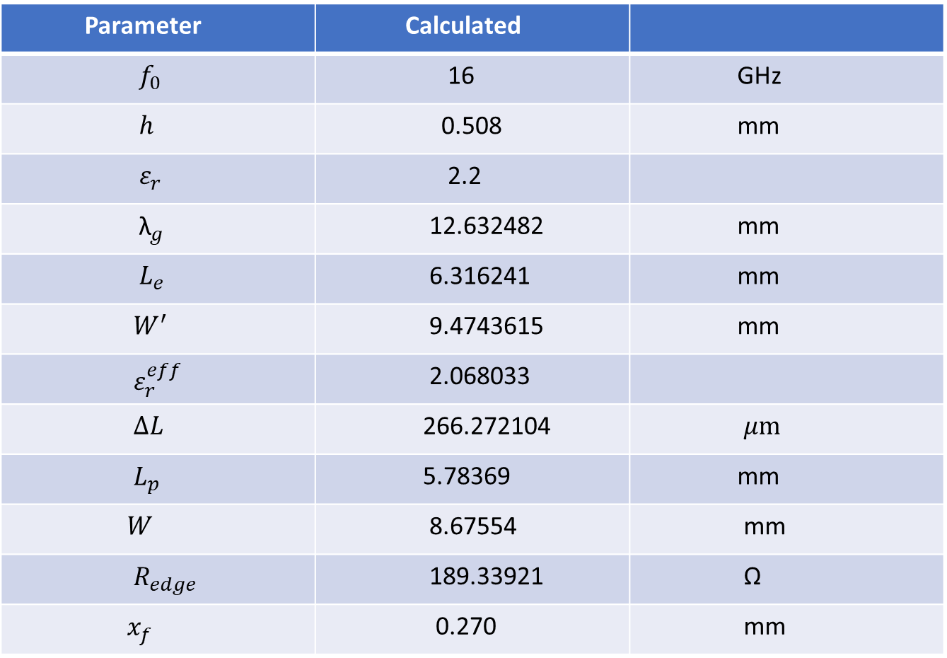
Table 1
Parameter | Calculated
$f_{0}$ | 16 | GHz
$h$ | 0.508 | mm
$ε_{r}$ | 2.2
${\text{λ}}_{g}$ | 12.632482 | mm
$L_{e}$ | 6.316241 | mm
$W^{′}$ | 9.4743615 | mm
$ε_{r}^{eff}$ | 2.068033
$∆L$ | 266.272104 | $μm$
$L_{p}$ | 5.78369 | mm
$W$ | 8.67554 | mm
$R_{edge}$ | 189.33921 | Ω
$x_{f}$ | 0.270 | mm

Slide 8
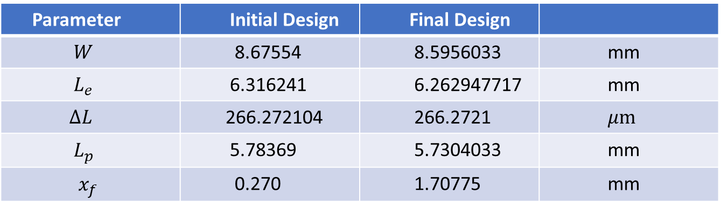
Table 2
Parameter | Initial Design | Final Design
$W$ | 8.67554 | 8.5956033 | mm
$L_{e}$ | 6.316241 | 6.262947717 | mm
$∆L$ | 266.272104 | 266.2721 | $μm$
$L_{p}$ | 5.78369 | 5.7304033 | mm
$x_{f}$ | 0.270 | 1.70775 | mm

Slide 9
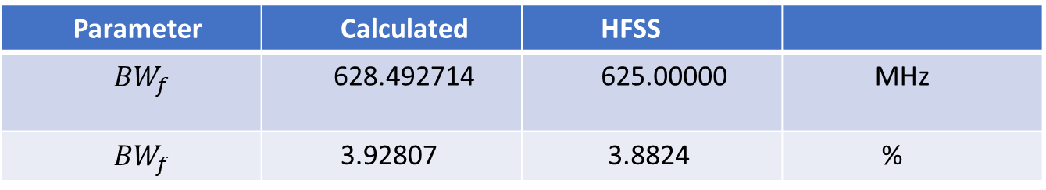
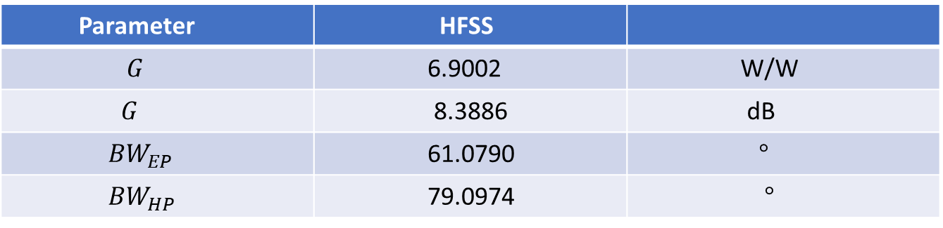
Table 3
Parameter | HFSS
$G$ | 6.9002 | W/W
$G$ | 8.3886 | dB
${BW}_{EP}$ | 61.0790 | $°$
${BW}_{HP}$ | 79.0974 | $°$
Table 4
Parameter | Calculated | HFSS
${BW}_{f}$ | 628.492714 | 625.00000 | MHz
${BW}_{f}$ | 3.92807 | 3.8824 | %

